Slide 1




Covariate Significance Testing
User Tutorial
Mahmoud Mostapha, Jared Vicory, Chao Huang, Martin Styner, Beatriz Paniagua
October 2019

Slide 2

Covariate Significance Testing Description
This module provides the following functions:
Model Fitting & Hypothesis Testing
Visualize Statistical Results

Slide 3
Description of Covariate Significance Testing
Covariate Significance Testing provides an interface for MFSDA (Multivariate Functional Shape Data Analysis) method, which is a Python based tool for statistical shape analysis.
A multivariate varying coefficient model is introduced to build the association between the multivariate shape measurements and demographic information and other clinical variables.
Statistical inference, i.e., hypothesis testing, is also included in this tool, which can be used in investigating whether some covariates of interest are significantly associated with the shape information. The hypothesis testing results are further used in clustering based analysis, i.e., significant suregion detection.

Slide 4
Description of Covariate Significance Testing
The Covariate Significance Testing tool has of the following structure:
A single CSV file containing the location of the surface meshes and the corresponding covariates to be tested
A VTK file providing a common coordinates for input surfaces
A VTK file providing a shape template for visualizing p-values
Inputs: Surface Meshes + Covariate Matrix + Spherical Template + Shape Template
Covariate Significance Testing uses MFSDA_run & MFSDA_createShapes CLIs
Output: Fitted Model Parameters + P-Values + Shape Template Mesh with Scalars
A JSON file containing the parameters of the fitted statistical model
A JSON file containing the resultant p-values
A VTK file of the input shape template with fitted model parameters and p-values as point data scalars for visualization

Slide 5
Installation of Covariate Significance Testing Tool
Covariate Significance Testing tool can be used with SlicerSALT platform as a module, which is the dissemination vehicle of powerful shape analysis methodology. This software is a light-weight, customized version of 3D Slicer.

Slide 6

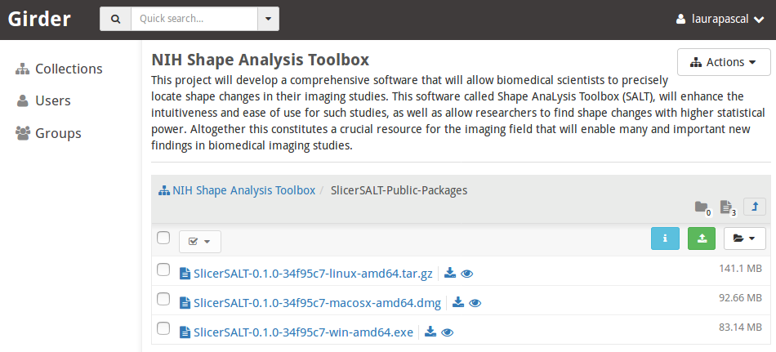

Covariate Significance Testing Installation on SlicerSALT
Download the SlicerSALT packages for your respective operating system from the SlicerSALT website and install it. Covariate Significance Testing will be ready to use as a module.
Powered by Girder

Slide 7
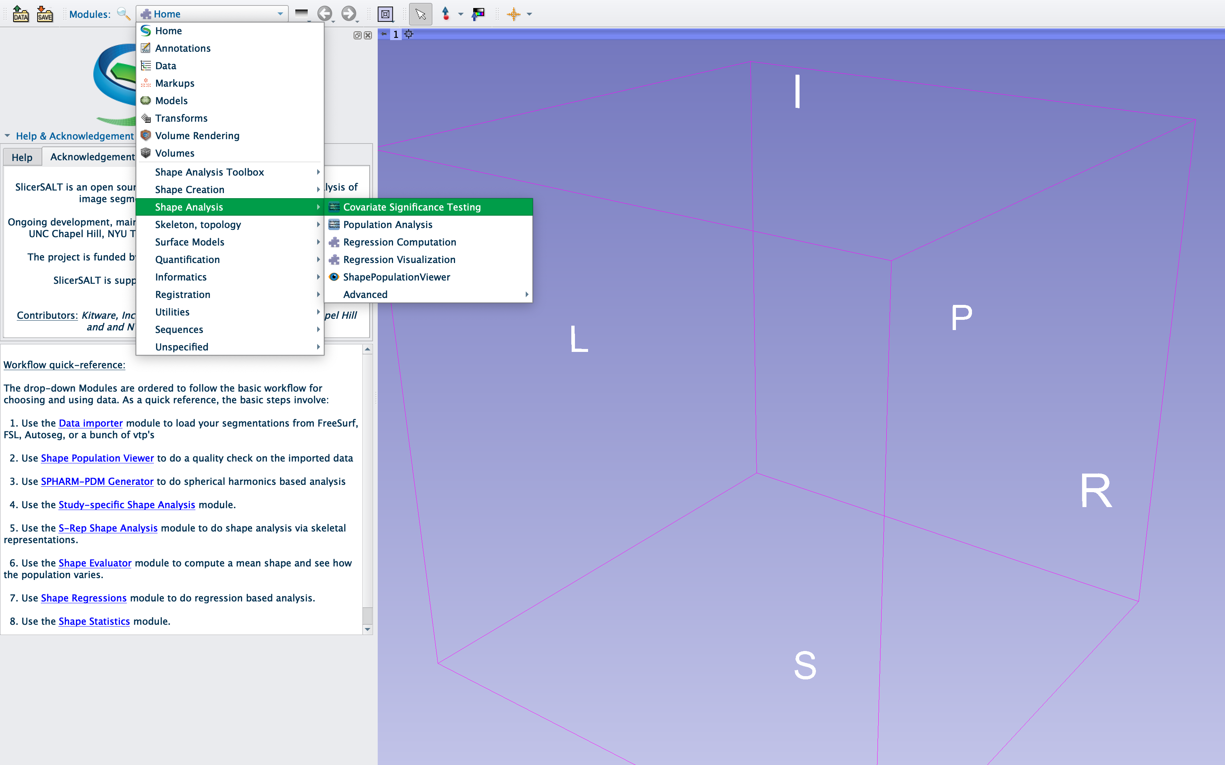
Covariate Significance Testing Module
In SlicerSALT, select Covariate Significance Testing Module from the Modules drop-down menu (Category: Shape Analysis) or on the Search bar

Slide 8
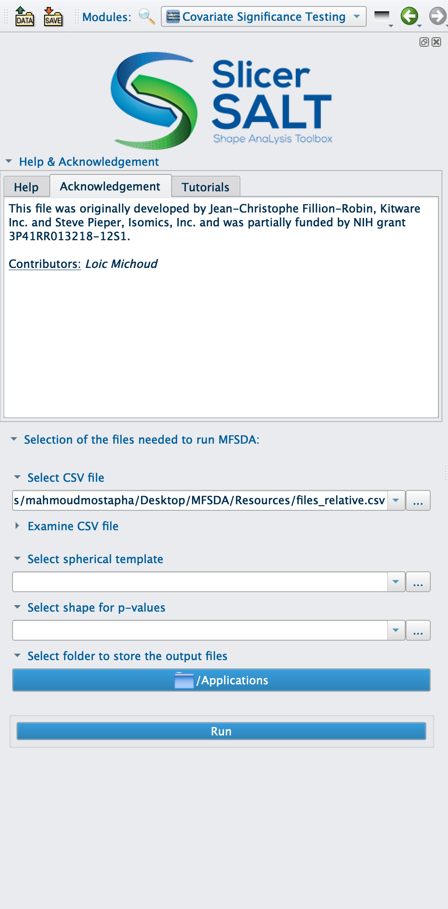
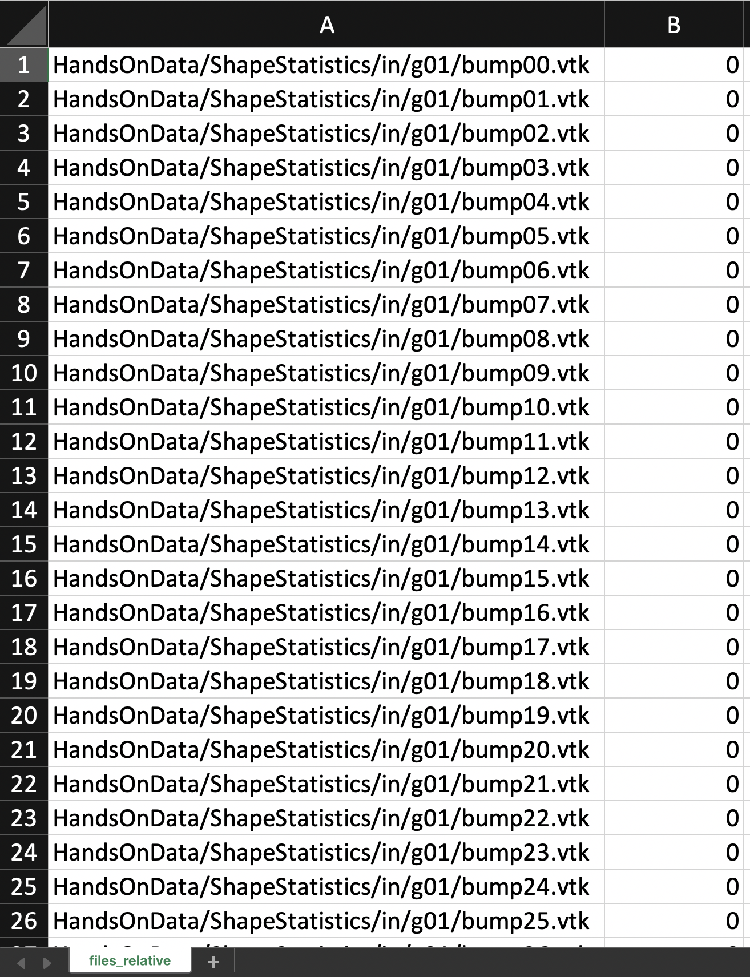
Setting up Input Files
For Input CSV File, select the csv file which contains the location of input surface meshes (*.vtk) and corresponding covariates
First column contains the location of input surface vtk files
Each additional column represent a covariate to be tested, which can be categorical or continuous
Example of an input CSV file with one categorical covariate

Slide 9
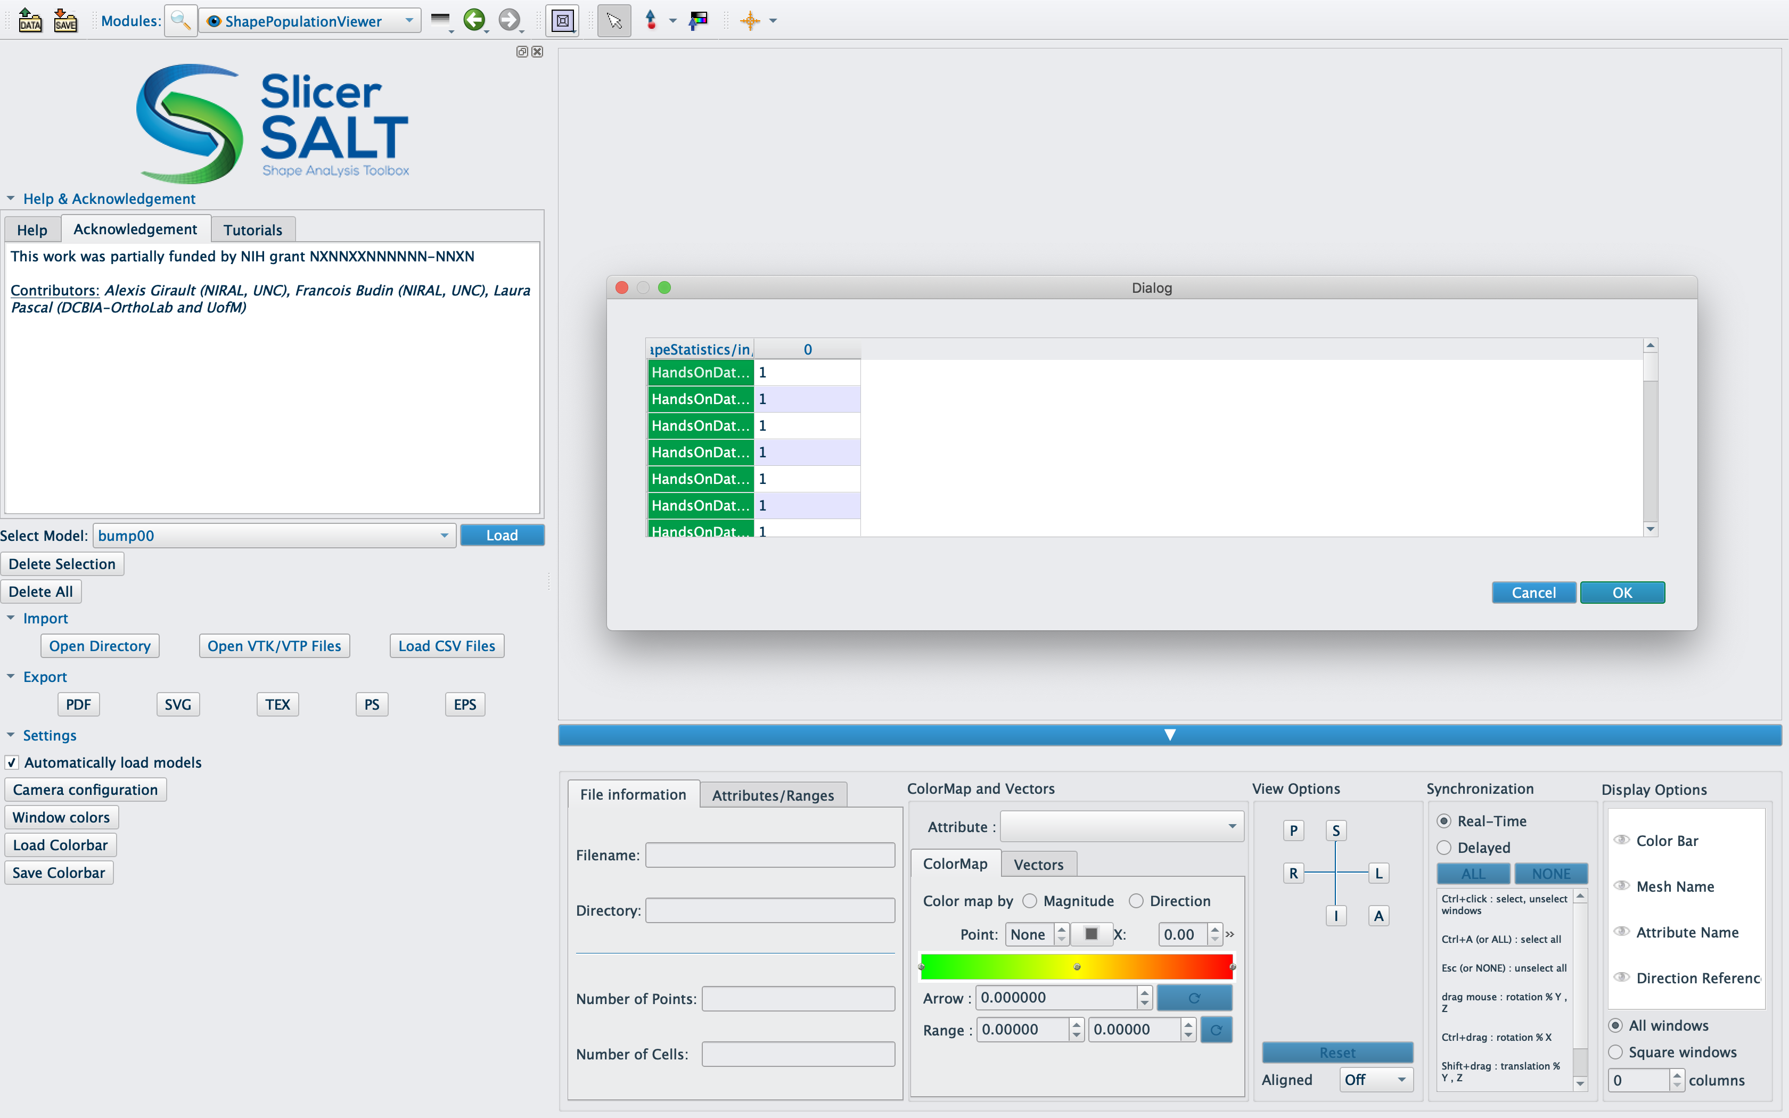
Input Surface Meshes Visualization
Shape Population Viewer can be used to check the input surface meshes, where the same CSV file as its input

Slide 10
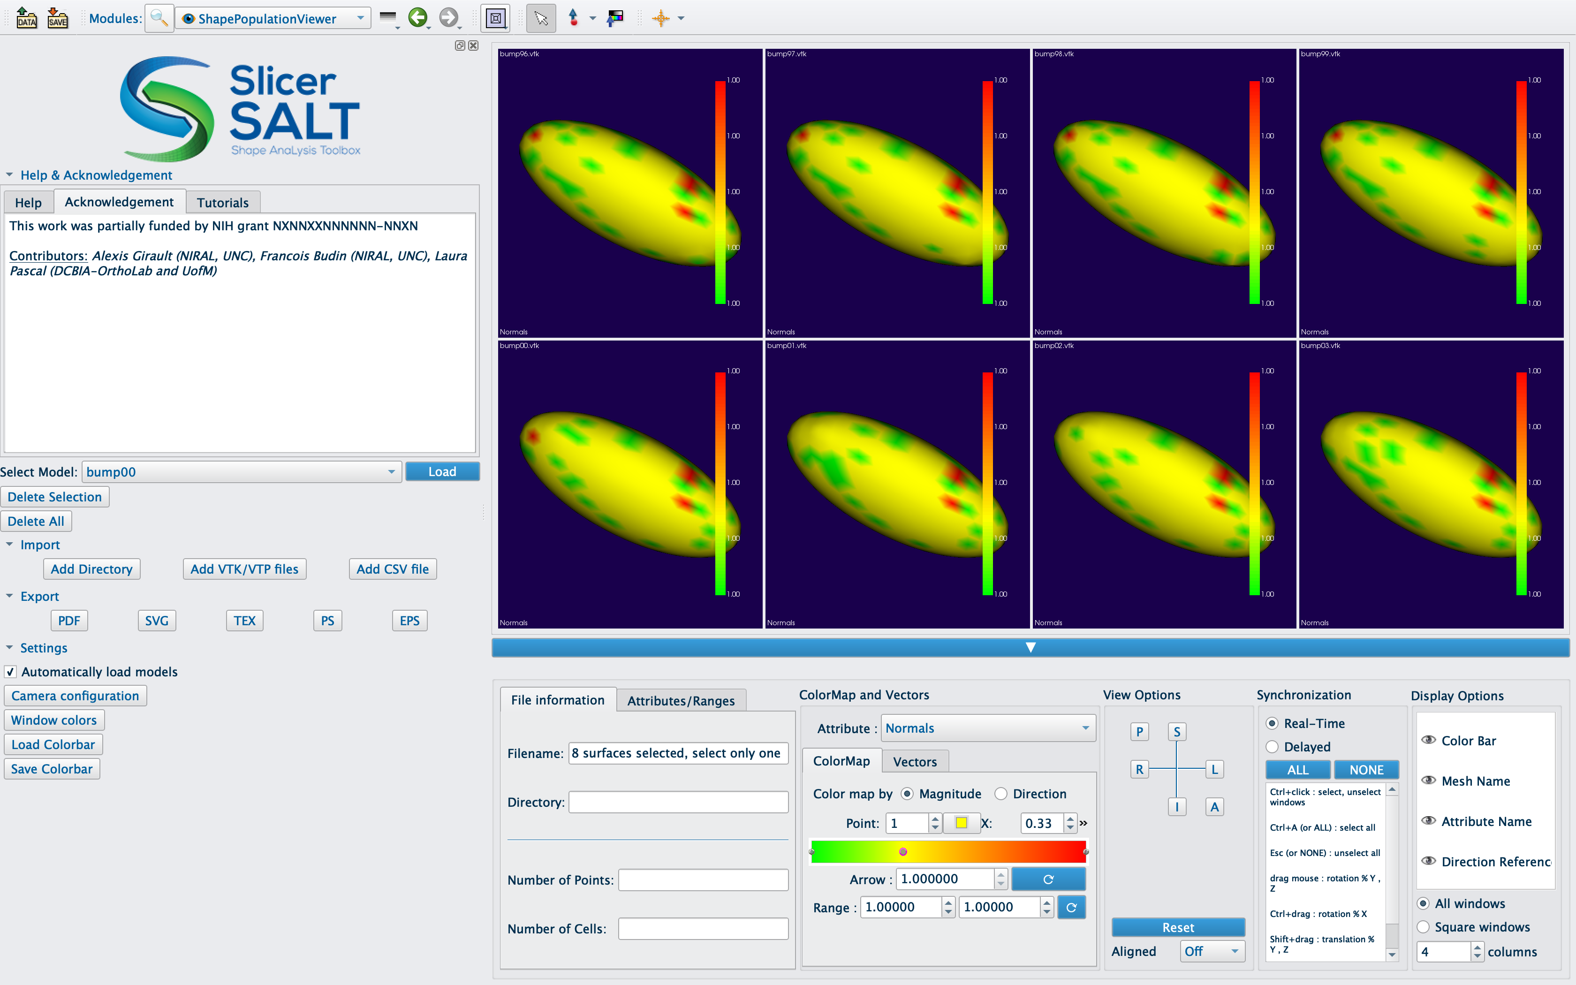
Input Surface Meshes Visualization

Slide 11
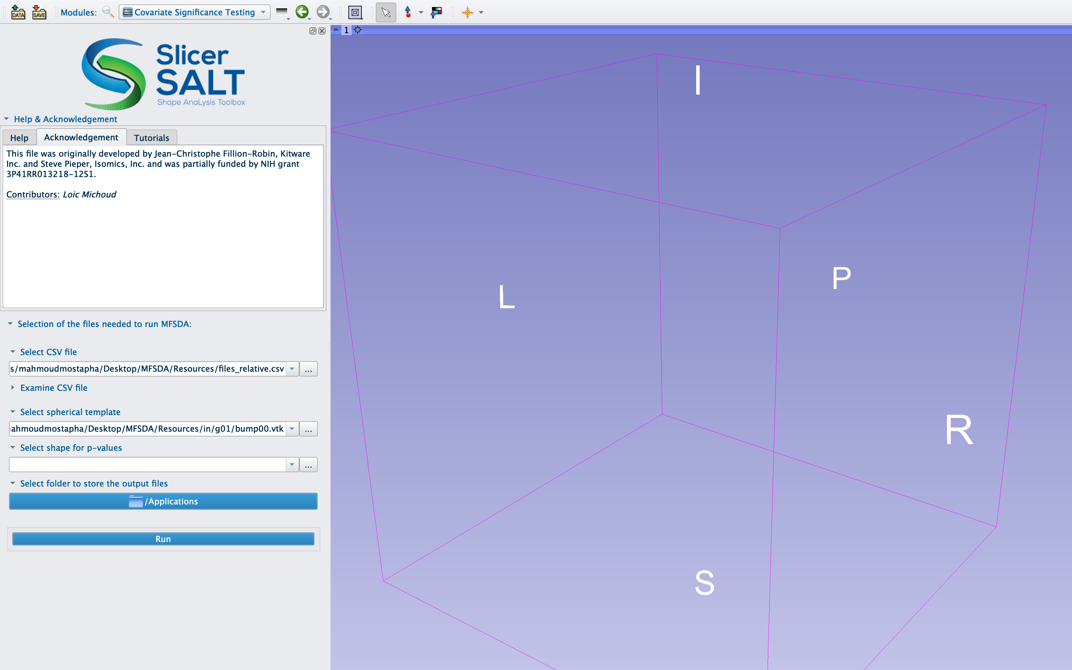
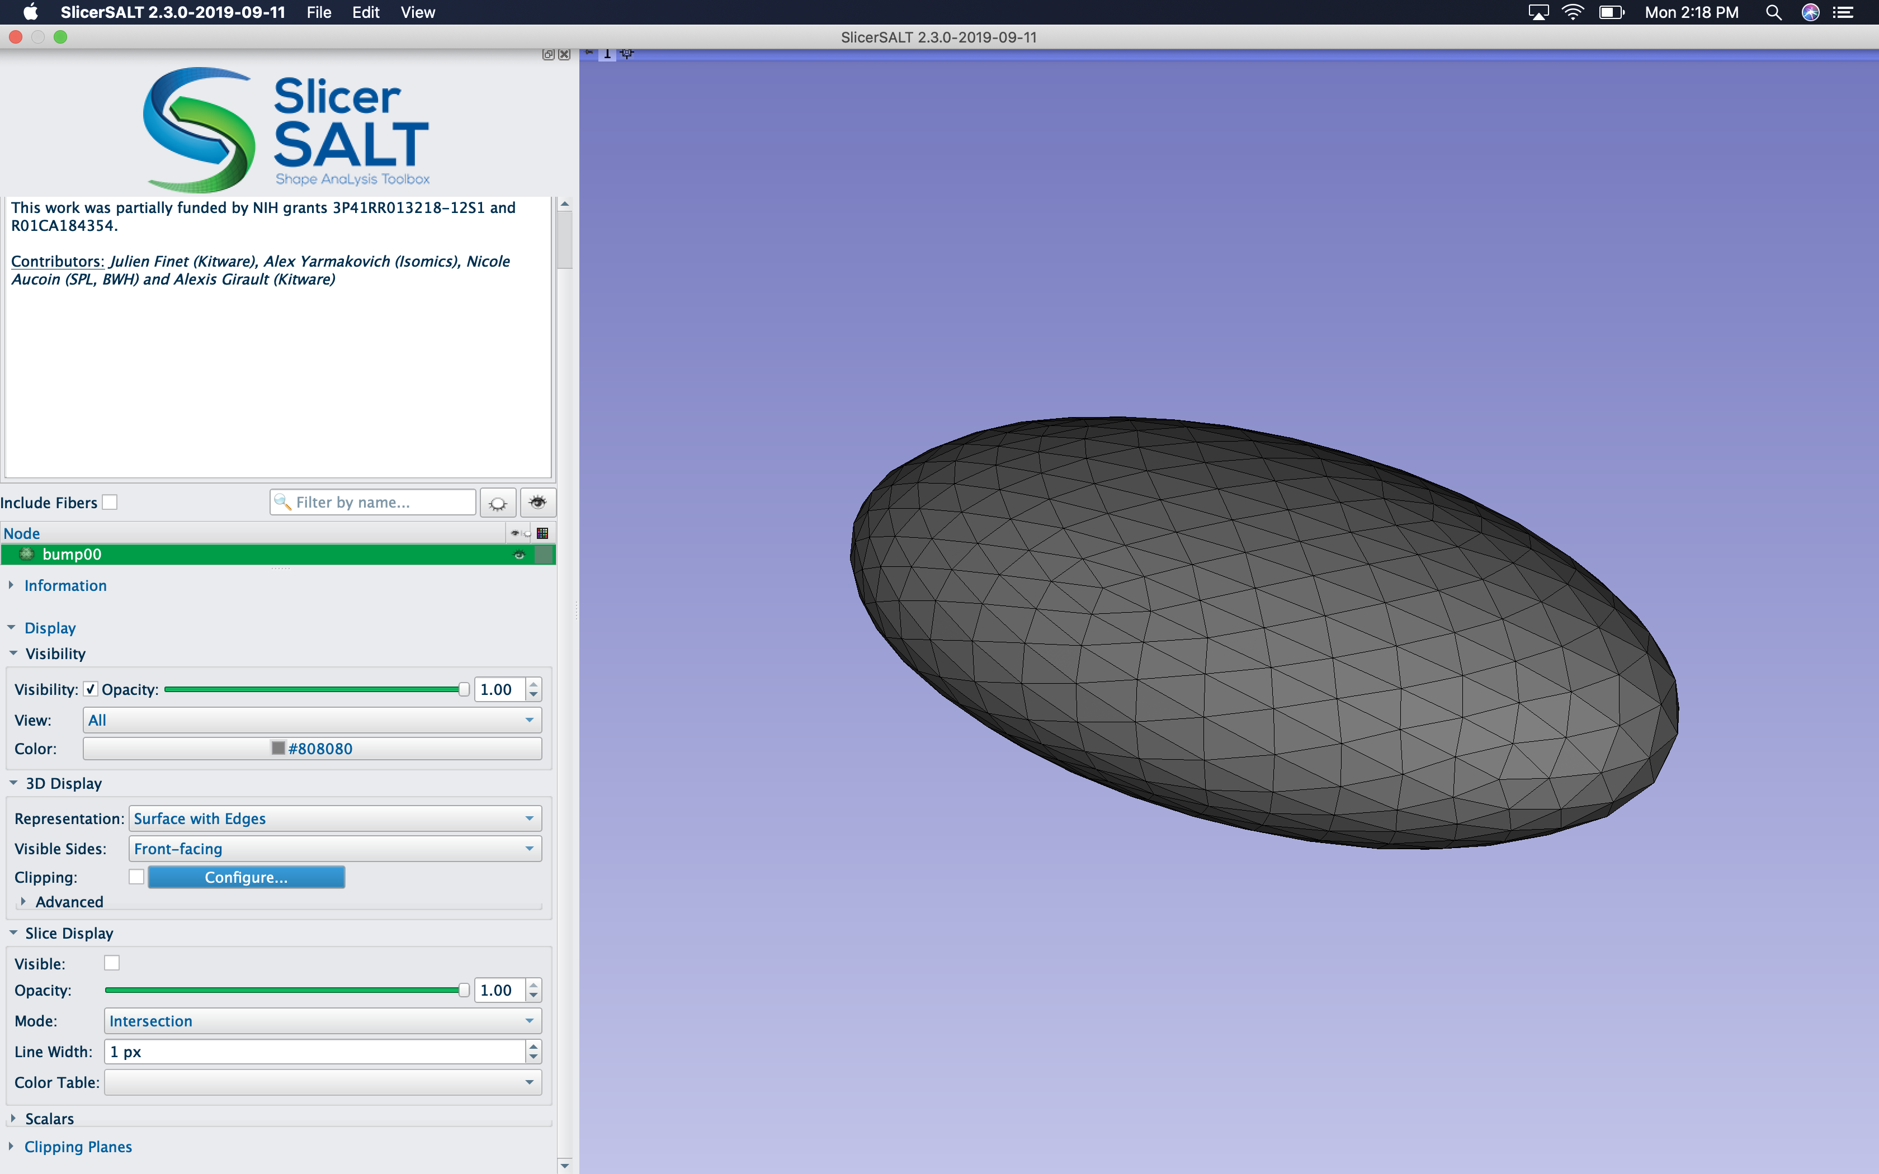
Setting up Input Files
For Input Spherical Template, select the vtk file which provides a common coordinates for the of input surface meshes
Example of an input spherical template file, which can be an average surface or one of the input surfaces

Slide 12
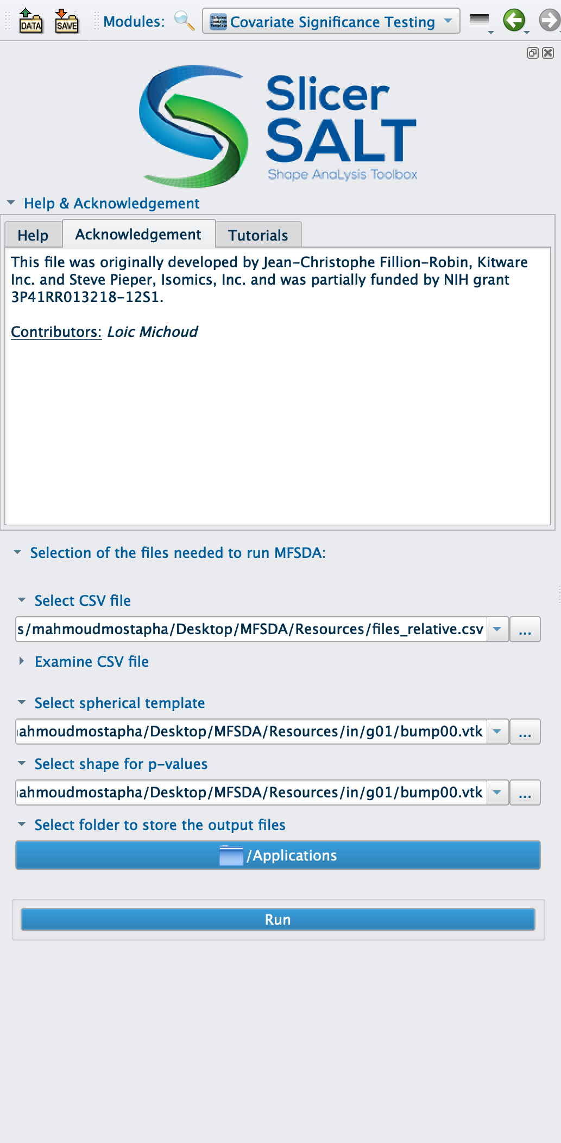
Setting up Input Files
For Input Shape for p-values, select the vtk file which will be used to visualize the fitted model parameters and the resulted p-values
Example of an input shape for p-values file, which can be an average surface or one of the input surfaces

Slide 13

Setting up Output Directory
For Output Files Directory, select the folder where the module will store the output files

Slide 14
Running Covariate Significance Testing Module
Click on the Run button, to run the MFSDA_run & MFSDA_createShapes CLIs on the provided inputs files

Slide 15
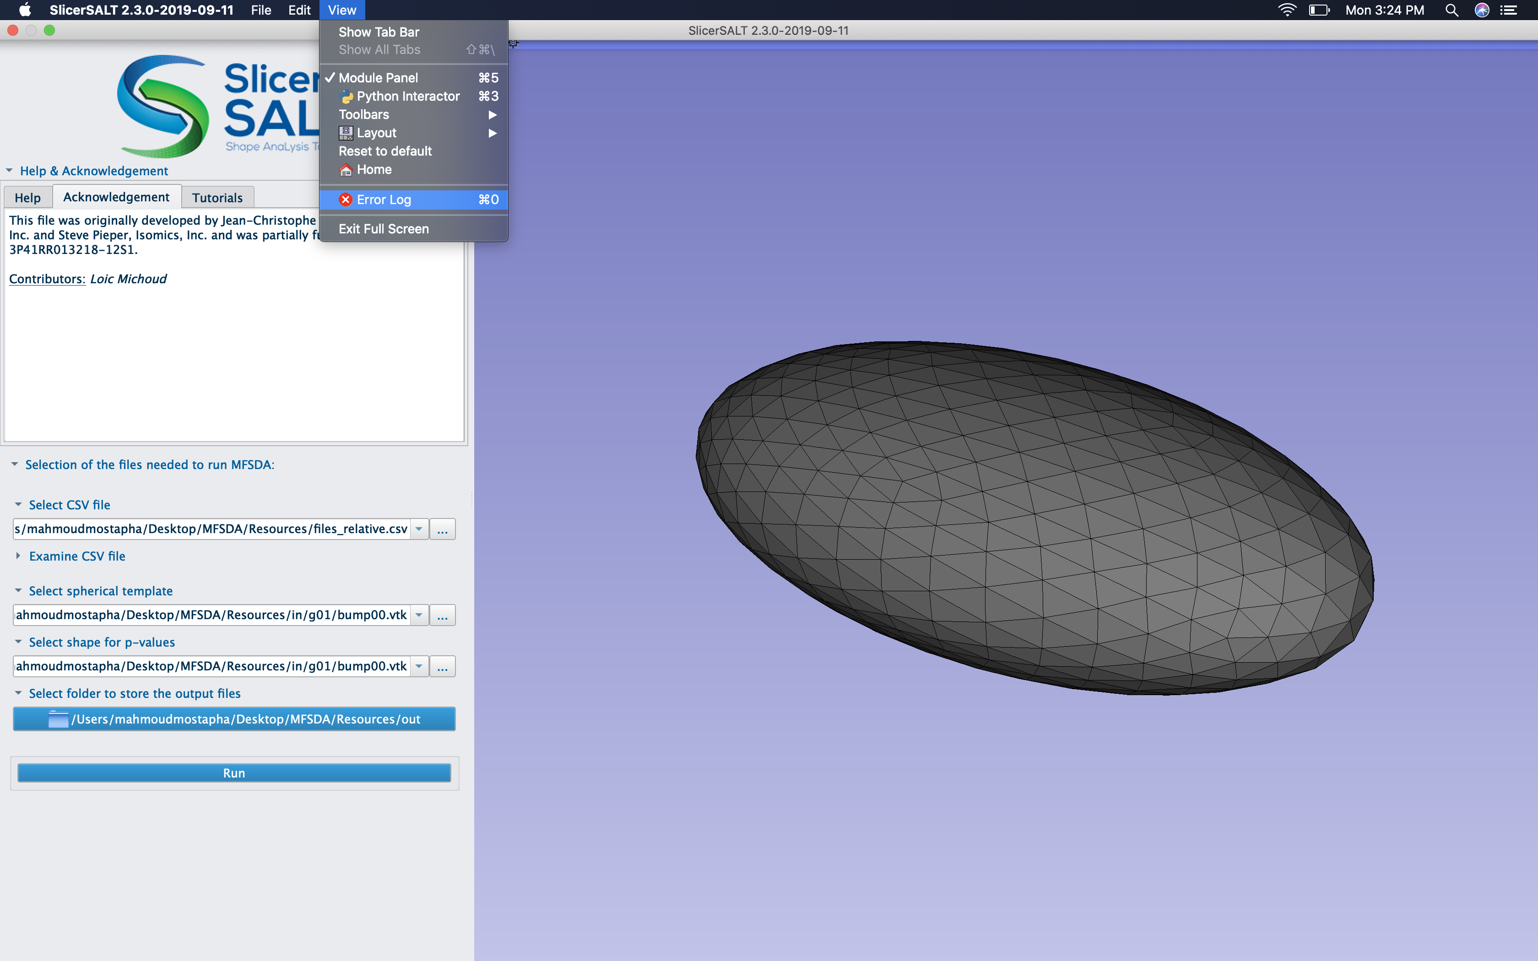
Debugging
SlicerSALT Error Log can also be used for debugging if the module was completed with errors.

Slide 16
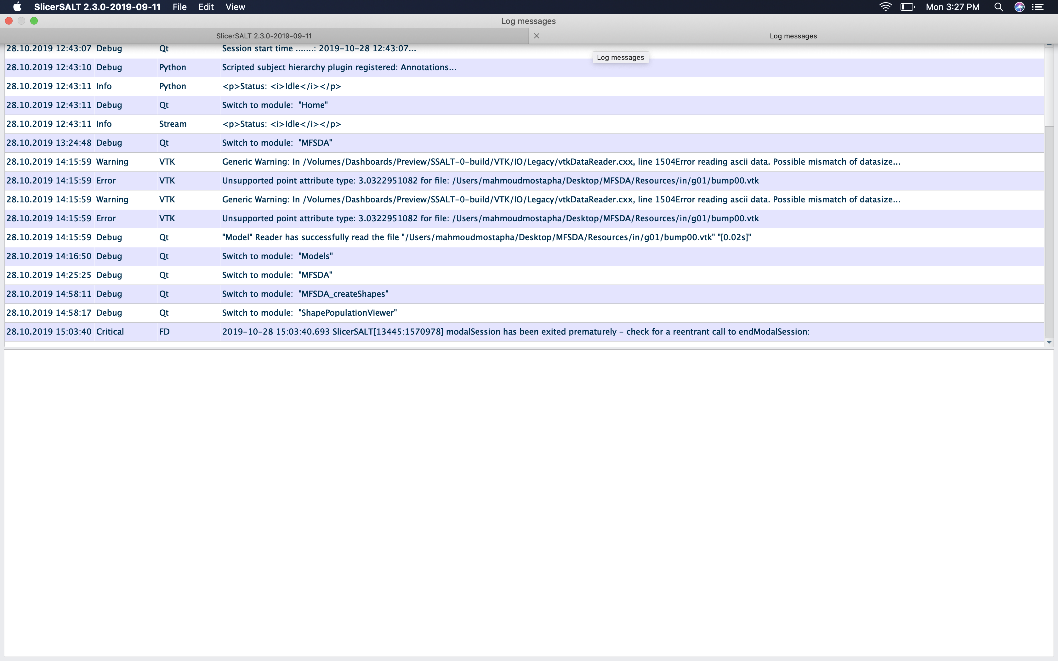
Debugging
SlicerSALT Error Log can also be used for debugging if the module was completed with errors.

Slide 17
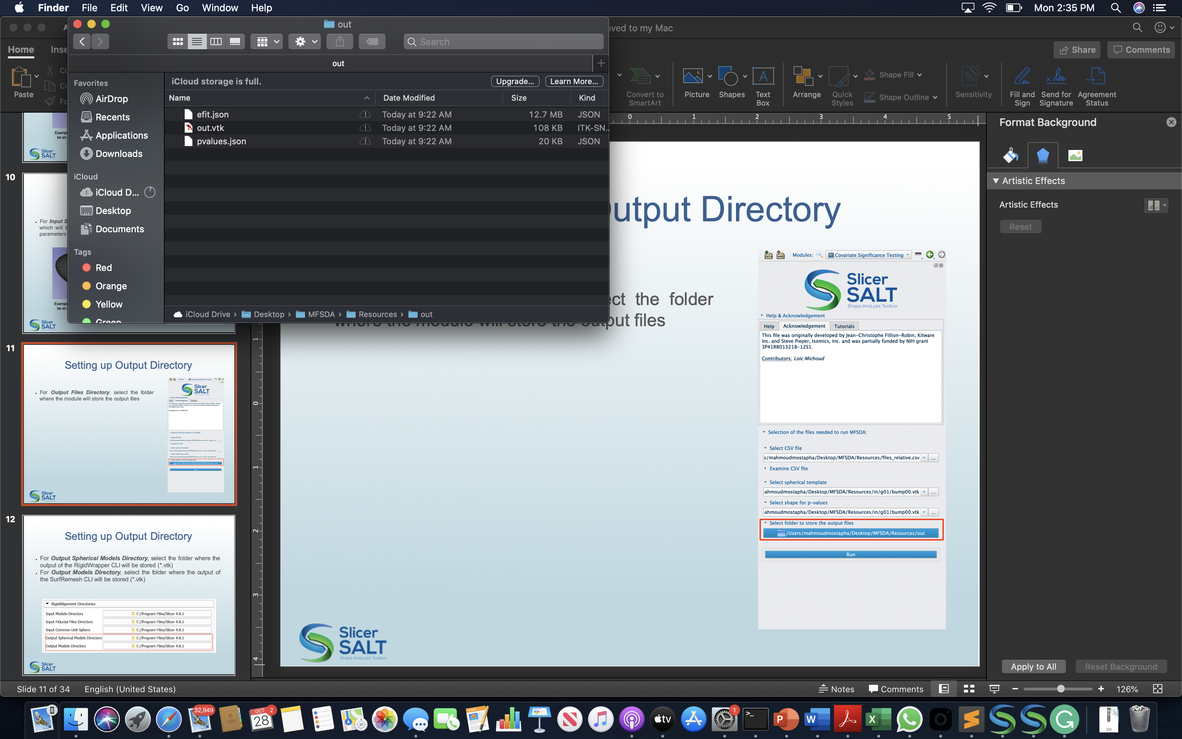
Output Files
The outputs files for the Covariate Significance Testing Module are stored in the output folder specified by the user:
Fitted model parameters
Shape template with Scalars
Hypothesis testing p-values
The output files generated by running Covariate Significance Testing

Slide 18
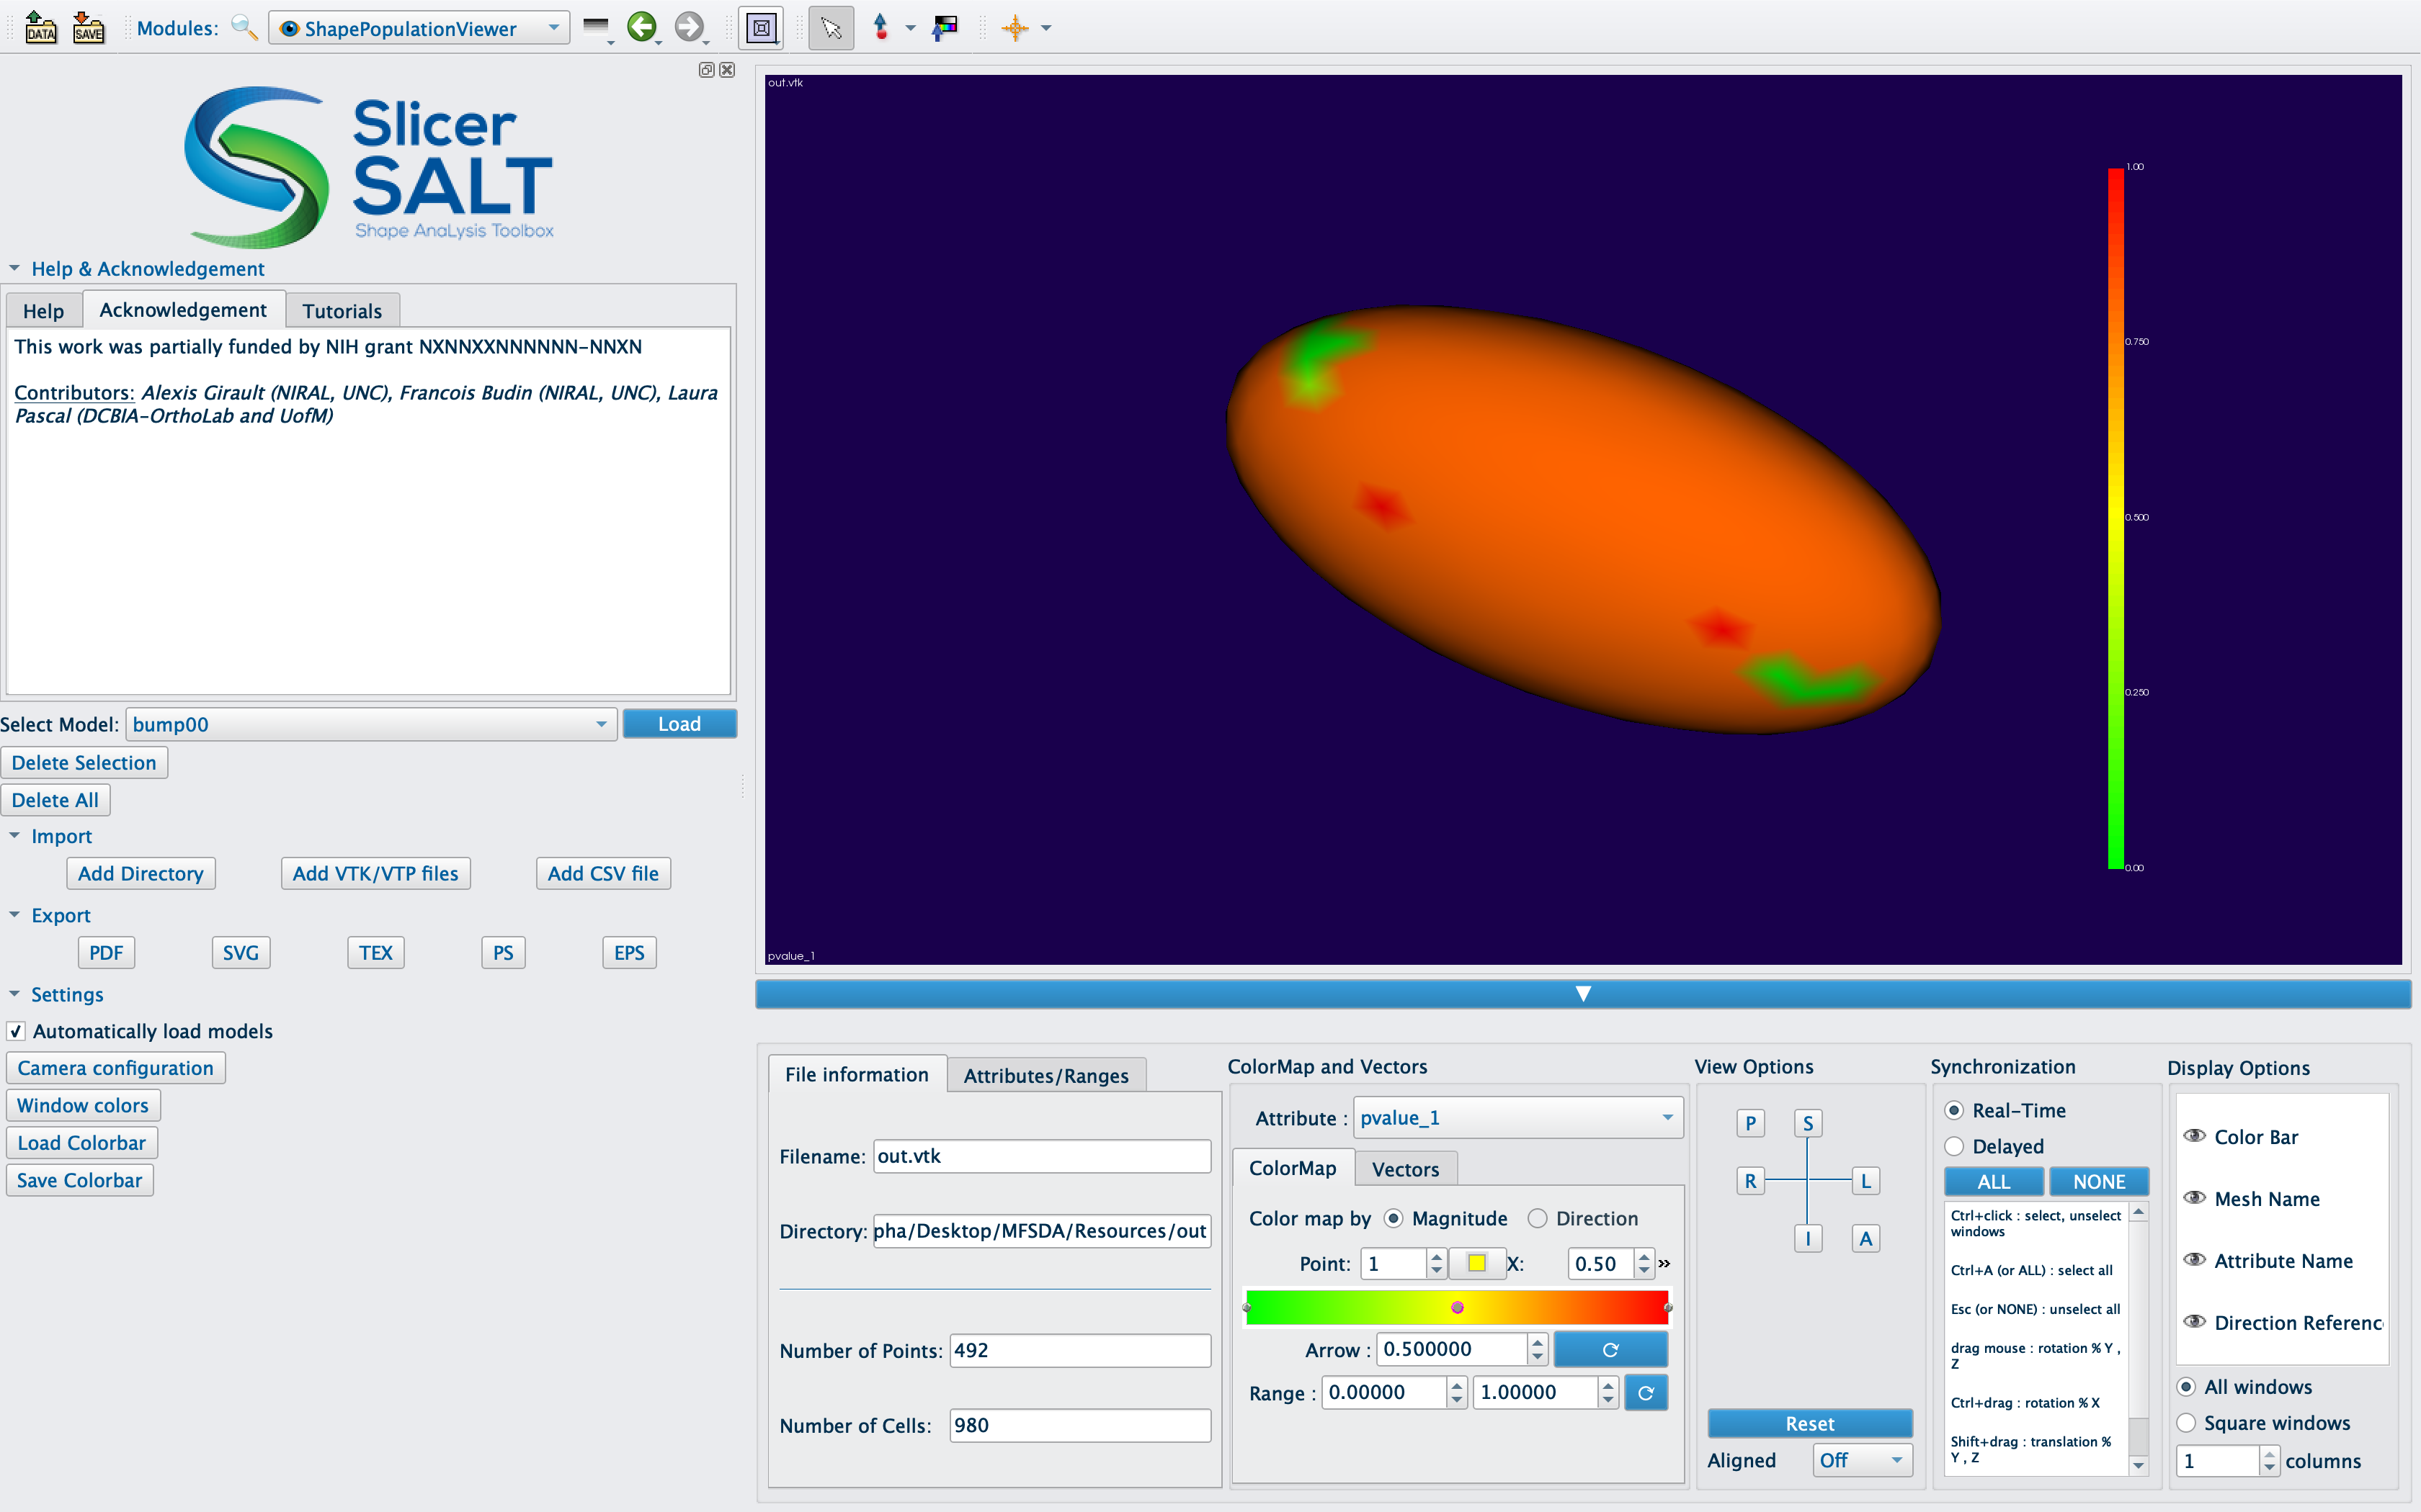
Output Shape Template Visualization
Shape Population Viewer can be used also to visualize the output shape template with fitted model parameters and p-values as scalars

Slide 19

Acknowledgements - Resources - Questions
The MFSDA developers gratefully acknowledge funding for this project provided by NIH NIBIB R01EB021391 (Shape Analysis Toolbox for Medical Image Computing Projects), as well as the Slicer community.
Github repository:
MFSDA
SlicerSALT
3D Slicer
Forums:
SlicerSALT
3D Slicer
For other remarks or questions, please email:
mahmoudm@cs.unc.edu

